Slide 1
CS2040S Tutorial 9

Slide 2
Administrative Matters
Attendance taking
PS7 Feedback if any

Slide 3
Today’s tutorial
Content recap (Adjacency list vs matrix, DFS BFS)
Tutorial questions

Slide 4
Graph representation

Slide 5
Graph Representation
What is a Graph?

Slide 6
Graph Representation
What is a Graph?
Graph consists of:
V, a set of nodes/vertices
E, a set of edges

Slide 7
Graph Representation
What is a Graph?
Graph consists of:
V, a set of nodes/vertices
E, a set of edges
How do you represent Graphs in a program?

Slide 8
Graph Representation
What is a Graph?
Graph consists of:
V, a set of nodes/vertices
E, a set of edges
How do you represent Graphs in a program?
Adjacency List
Adjacency Matrix

Slide 9
Adjacency List (Undirected Graph)
Adapted from CLRS
How to represent this?
1
2
3
5
4

Slide 10
Adjacency List (Undirected Graph)
Adapted from CLRS
How to represent this? Array: The nodes
1
1
2
2
3
3
5
4
4
5

Slide 11
Adjacency List (Undirected Graph)
Adapted from CLRS
How to represent this? Array: The nodes Linked List: The edges representing the other nodes it is connected to
1
2
5
1
2
2
3
1
4
5
3
3
4
2
5
4
4
2
5
3
5
1
2
4

Slide 12
Adjacency List (Undirected Graph)
Adapted from CLRS
How to represent this? Array: The nodes Linked List: The edges representing the other nodes it is connected to
1
2
5
1
2
2
3
1
4
5
3
3
4
2
5
4
4
2
5
3
5
1
2
4

Slide 13
Adjacency List (Undirected Graph)
Adapted from CLRS
How to represent this? Array: The nodes Linked List: The edges representing the other nodes it is connected to
1
2
5
1
2
2
3
1
4
5
3
3
4
2
5
4
4
2
5
3
5
1
2
4

Slide 14
Adjacency List (Undirected Graph)
Adapted from CLRS
How to represent this? Array: The nodes Linked List: The edges representing the other nodes it is connected to
1
2
5
1
2
2
3
1
4
5
3
3
4
2
5
4
4
2
5
3
5
1
2
4

Slide 15
Adjacency Matrix (Undirected Graph)
Adapted from CLRS
How to represent this?
1
2
3
5
4

Slide 16
Adjacency Matrix (Undirected Graph)
Adapted from CLRS
How to represent this? Matrix A: A[u][v] == 1 iff (u, v) ∈ E
1
2
3
4
5
1
2
1
0
1
0
0
1
2
1
0
1
1
1
3
3
0
1
0
1
0
5
4
4
0
1
1
0
1
5
1
1
0
1
0

Slide 17
Adjacency Matrix (Undirected Graph)
Adapted from CLRS
How to represent this? Matrix A: A[u][v] == 1 iff (u, v) ∈ E
1
2
3
4
5
1
2
1
0
1
0
0
1
2
1
0
1
1
1
3
3
0
1
0
1
0
5
4
4
0
1
1
0
1
5
1
1
0
1
0

Slide 18
Adjacency Matrix (Undirected Graph)
Adapted from CLRS
How to represent this? Matrix A: A[u][v] == 1 iff (u, v) ∈ E
1
2
3
4
5
1
2
1
0
1
0
0
1
2
1
0
1
1
1
3
3
0
1
0
1
0
5
4
4
0
1
1
0
1
5
1
1
0
1
0

Slide 19
Adjacency Matrix (Undirected Graph)
Adapted from CLRS
How to represent this? Matrix A: A[u][v] == 1 iff (u, v) ∈ E
1
2
3
4
5
1
2
1
0
1
0
0
1
2
1
0
1
1
1
3
3
0
1
0
1
0
5
4
4
0
1
1
0
1
5
1
1
0
1
0

Slide 20
Adjacency List (Directed Graph)
Adapted from CLRS
How to represent this? Array: The nodes Linked List: The edges representing the other nodes it is connected to
1
1
2
2
3
3
5
4
4
5

Slide 21
Adjacency List (Directed Graph)
Adapted from CLRS
How to represent this? Array: The nodes Linked List: The edges representing the other nodes it is connected to
1
2
5
1
2
2
3
3
2
5
4
4
3
2
5
4
2

Slide 22
Adjacency List (Directed Graph)
Adapted from CLRS
How to represent this? Array: The nodes Linked List: The edges representing the other nodes it is connected to
1
2
5
1
2
2
3
3
2
5
4
4
3
2
5
4
2

Slide 23
Adjacency List (Directed Graph)
Adapted from CLRS
How to represent this? Array: The nodes Linked List: The edges representing the other nodes it is connected to
1
2
5
1
2
2
3
3
2
5
4
4
3
2
5
4
2

Slide 24
Adjacency List (Directed Graph)
Adapted from CLRS
How to represent this? Array: The nodes Linked List: The edges representing the other nodes it is connected to
1
2
5
1
2
2
3
3
2
5
4
4
3
2
5
4
2

Slide 25
Adjacency Matrix (Directed Graph)
Adapted from CLRS
How to represent this?
1
2
3
5
4

Slide 26
Adjacency Matrix (Directed Graph)
Adapted from CLRS
How to represent this? Matrix A: A[u][v] == 1 iff (u, v) ∈ E Note: (u, v) is different from (v, u) if edges are directed
1
2
3
4
5
1
2
1
0
1
0
0
1
2
0
0
0
0
0
3
3
0
1
0
0
0
5
4
4
0
1
1
0
0
5
0
1
0
1
0

Slide 27
Adjacency Matrix (Directed Graph)
Adapted from CLRS
How to represent this? Matrix A: A[u][v] == 1 iff (u, v) ∈ E Note: (u, v) is different from (v, u) if edges are directed
1
2
3
4
5
1
2
1
0
1
0
0
1
2
0
0
0
0
0
3
3
0
1
0
0
0
5
4
4
0
1
1
0
0
5
0
1
0
1
0

Slide 28
Adjacency Matrix (Directed Graph)
Adapted from CLRS
How to represent this? Matrix A: A[u][v] == 1 iff (u, v) ∈ E Note: (u, v) is different from (v, u) if edges are directed
1
2
3
4
5
1
2
1
0
1
0
0
1
2
0
0
0
0
0
3
3
0
1
0
0
0
5
4
4
0
1
1
0
0
5
0
1
0
1
0

Slide 29
Adjacency Matrix (Directed Graph)
Adapted from CLRS
How to represent this? Matrix A: A[u][v] == 1 iff (u, v) ∈ E Note: (u, v) is different from (v, u) if edges are directed
1
2
3
4
5
1
2
1
0
1
0
0
1
2
0
0
0
0
0
3
3
0
1
0
0
0
5
4
4
0
1
1
0
0
5
0
1
0
1
0

Slide 30
Graph Representations
Space complexity?
1
1
2
3
4
5
2
5
1
2
1
0
1
0
0
1
2
3
1
4
5
2
1
0
1
1
1
3
3
4
2
3
0
1
0
1
0
5
4
4
0
1
1
0
1
4
2
5
3
5
1
1
0
1
0
5
1
2
4

Slide 31
Graph Representations
Space complexity?
O(V + E)
O(V²)
1
1
2
3
4
5
2
5
1
2
1
0
1
0
0
1
2
3
1
4
5
2
1
0
1
1
1
3
3
4
2
3
0
1
0
1
0
5
4
4
0
1
1
0
1
4
2
5
3
5
1
1
0
1
0
5
1
2
4

Slide 32
Graph Representations
Space complexity?
O(V + E) => O(V^2) for complete graph
O(V²)
1
1
2
3
4
5
2
5
1
2
1
0
1
0
0
1
2
3
1
4
5
2
1
0
1
1
1
3
3
4
2
3
0
1
0
1
0
5
4
4
0
1
1
0
1
4
2
5
3
5
1
1
0
1
0
5
1
2
4

Slide 33
Graph traversal
BFS/DFS

Slide 34
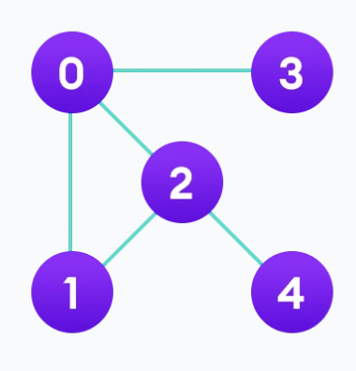
BFS

Slide 35
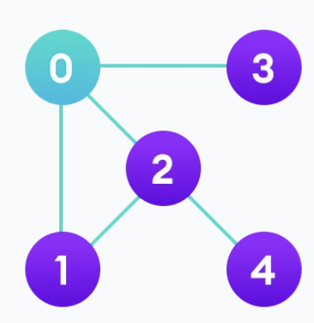
BFS

Slide 36
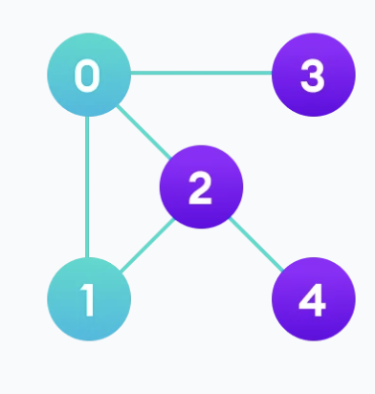
BFS

Slide 37
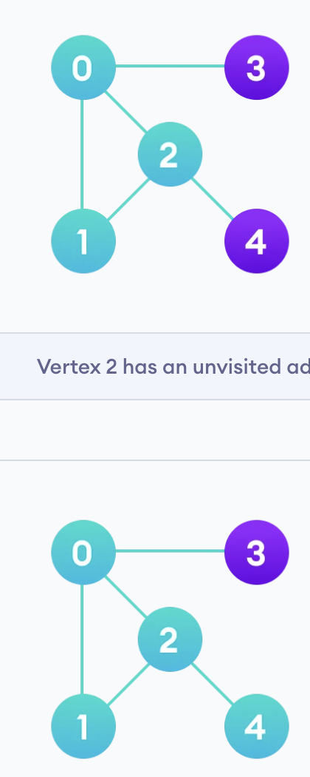
BFS

Slide 38
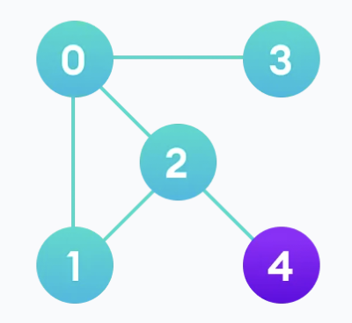
BFS

Slide 39
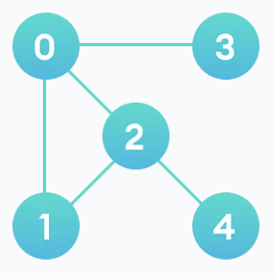
BFS

Slide 40
DFS

Slide 41
DFS

Slide 42
DFS

Slide 43
DFS

Slide 44
DFS

Slide 45
DFS

Slide 46
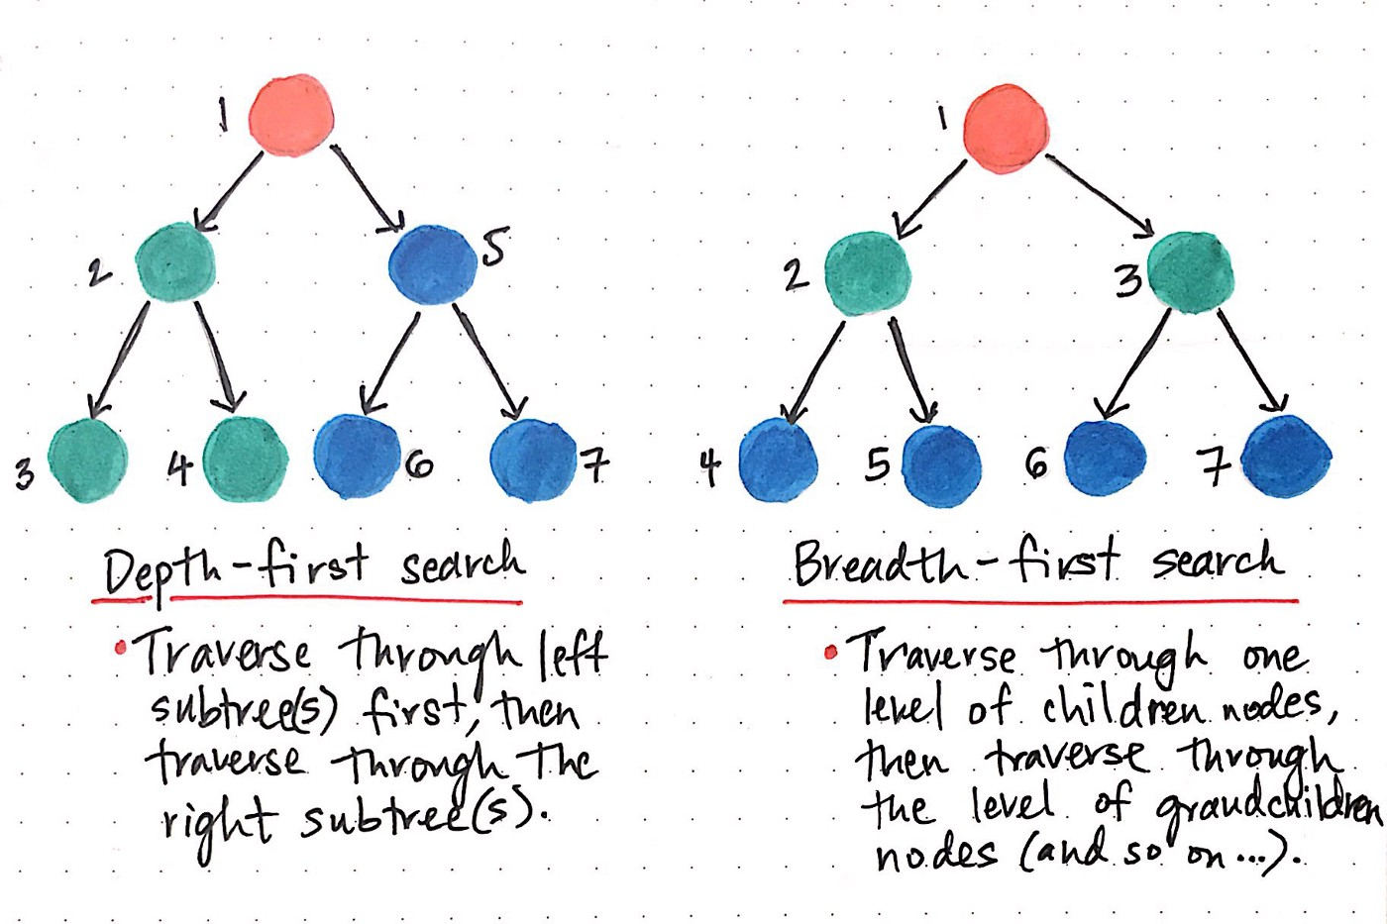
further reference reading https://medium.com/basecs/breaking-down-breadth-first-search-cebe696709d9

Slide 47
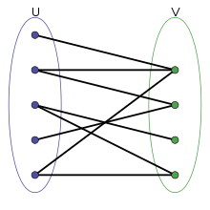
Important reminders!
Every node is visited once and only once - you never revisit a node
Bipartite graph: all edges connect one element in set u to 1 element in set v
Connected graph of n nodes has at least n-1 edges
If it has exactly n-1 edges, it is a tree, and it has no cycles

Slide 48
Tutorial

Slide 49
Problem 1a
Recall that when performing DFS or BFS, we may keep track of a parent pointer
that indicates the very first time that a node was visited. Explain why these parent edges form a tree (i.e., why there are no cycles).

Slide 50
Problem 1a
Recall that when performing DFS or BFS, we may keep track of a parent pointer
that indicates the very first time that a node was visited. Explain why these parent edges form a tree (i.e., why there are no cycles).
Edge is only added when the node is visited for the first time

Slide 51
Problem 1a
Recall that when performing DFS or BFS, we may keep track of a parent pointer
that indicates the very first time that a node was visited. Explain why these parent edges form a tree (i.e., why there are no cycles).
Edge is only added when the node is visited for the first time
A total of n-1 new nodes will be discovered starting from source node (n-1 edges total)

Slide 52
Problem 1a
Recall that when performing DFS or BFS, we may keep track of a parent pointer
that indicates the very first time that a node was visited. Explain why these parent edges form a tree (i.e., why there are no cycles).
Edge is only added when the node is visited for the first time
A total of n-1 new nodes will be discovered starting from source node (n-1 edges total)
Forms one connected component → of n nodes and n-1 edges

Slide 53
Problem 1a
Recall that when performing DFS or BFS, we may keep track of a parent pointer
that indicates the very first time that a node was visited. Explain why these parent edges form a tree (i.e., why there are no cycles).
Edge is only added when the node is visited for the first time
A total of n-1 new nodes will be discovered starting from source node (n-1 edges total)
Forms one connected component → of n nodes and n-1 edges → must be a tree (if not tree, there must be disconnected components which is a contradiction)
This tree is known as BFS/DFS-spanning tree.

Slide 54
Problem 1b
How does DFS or BFS on a tree relate to DFS or BFS on a graph? Are they the same algorithm?
Trees are a type of graph! BFS/DFS for graphs are generalized version and will work for trees.

Slide 55
Problem 1b
How does DFS or BFS on a tree relate to DFS or BFS on a graph? Are they the same algorithm?
Trees are a type of graph! BFS/DFS for graphs are generalized version and will work for trees.
For the tree version of BFS/DFS, we did not keep track of visited nodes, why?

Slide 56
Problem 1b
How does DFS or BFS on a tree relate to DFS or BFS on a graph? Are they the same algorithm?
Trees are a type of graph! BFS/DFS for graphs are generalized version and will work for trees.
For the tree version of BFS/DFS, we did not keep track of visited nodes, why?
Trees are guaranteed to not have a cycle! No need to keep track of visited since its impossible to visit a node twice.
Tree version of BFS/DFS cannot be generalized for all graphs!

Slide 57
Problem 1b
What happens if you run DFS/BFS on a tree but do not start at the root?

Slide 58
Problem 1b
What happens if you run DFS/BFS on a tree but do not start at the root?
Works just as normal!
In fact, the BFS/DFS on the non-root node X will generate a new tree rooted at X
Recall BFS/DFS spanning tree from Problem 1a
Notes:
feel like a diagram here might be helpful

Slide 59
Problem 2
Given an undirected graph G = (V;E) as an adjacency list, give an algorithm to:
(i) determine if the graph is connected;
(ii) return the number of connected components (CC) in the graph.

Slide 60
Problem 2
Given an undirected graph G = (V;E) as an adjacency list, give an algorithm to:
(i) determine if the graph is connected;
(ii) return the number of connected components (CC) in the graph.
i) To check if graph is connected, pick any node and perform BFS/DFS, resulting tree must contain all nodes → every node is reachable from starting node

Slide 61
Problem 2
Given an undirected graph G = (V;E) as an adjacency list, give an algorithm to:
(i) determine if the graph is connected;
(ii) return the number of connected components (CC) in the graph.
i) To check if graph is connected, pick any node and perform BFS/DFS, resulting tree must contain all nodes → every node is reachable from starting node
ii) If graph is connected → return 1

Slide 62
Problem 2
Given an undirected graph G = (V;E) as an adjacency list, give an algorithm to:
(i) determine if the graph is connected;
(ii) return the number of connected components (CC) in the graph.
i) To check if graph is connected, pick any node and perform BFS/DFS. If resulting tree contains all nodes → every node is reachable from starting node → connected
ii) If graph is connected → return 1
If graph is not connected → run BFS/DFS on next unvisited nodes and “explore” the next connected components, return total number of BFS/DFS performed.

Slide 63
1
2
5
1
2
2
5
1
4
3
3
5
4
4
2
5
5
1
2
4

Slide 64
Problem 3
Given a connected graph with n nodes and m edges as an adjacency list. (You
are given n but not m; assume each adjacency list is given as a linked list, so you do not have access to its size.)
Give an algorithm to determine whether or not this graph is a tree. Your algorithm should run in O(n); particularly, it should be independent of m. Assume O(n + m) is too slow.
What guarantees a cycle in a graph of n nodes?

Slide 65
Problem 3
Given a connected graph with n nodes and m edges as an adjacency list. (You
are given n but not m; assume each adjacency list is given as a linked list, so you do not have access to its size.)
Give an algorithm to determine whether or not this graph is a tree. Your algorithm should run in O(n); particularly, it should be independent of m. Assume O(n + m) is too slow.
What guarantees a cycle in a graph of n nodes?
Any connected, undirected graph containing n nodes and > n - 1 edges has a cycle!

Slide 66
Problem 3
Solution:
Count number of edges in graph, if number of edges > n - 1, we can stop and conclude that the graph has a cycle! Early termination guarantees O(n)
How does it apply for adjacency list?

Slide 67
Problem 3
Solution:
Count number of edges in graph, if number of edges > n - 1, we can stop and conclude that the graph has a cycle! Early termination guarantees O(n)
How does it apply for adjacency list?
Each edge is represented twice in an adjacency list, therefore we need to count edges until > 2n - 2 before stopping and concluding presence of cycle

Slide 68
Problem 3
Solution:
Count number of edges in graph, if number of edges > n - 1, we can stop and conclude that the graph has a cycle! Early termination guarantees O(n)
How does it apply for adjacency list?
Each edge is represented twice in an adjacency list, therefore we need to count edges until > 2n - 2 before stopping and concluding presence of cycle
Otherwise, we are given the graph is connects, and verified it has n - 1 actual edges
→ Graph must be a tree

Slide 69
Problem 3
Bonus: What if the graph given is not guaranteed to be connected?

Slide 70
Problem 3
Bonus: What if the graph given is not guaranteed to be connected?
After verifying that the graph has n - 1 edges, run a BFS/DFS so check if all nodes can be reached → Can conclude presence of cycle

Slide 71
Problem 3
Bonus: What if the graph given is not guaranteed to be connected?
After verifying that the graph has n - 1 edges, run a BFS/DFS so check if all nodes can be reached → Can conclude presence of cycle

Slide 72
Problem 4 Graph Modeling
Here are a bunch of problems. How would you model them as a graph? (Do not worry about solving the actual problem. Just think about how you would model it as a graph problem.) Invent some of your own problems that can be modelled as graph problems – the stranger, the better.
Solving is not our focus, just modelling
Guiding questions:
What do our nodes represent?
What do our edges represent?
What are we trying to find in our graph?

Slide 73
Graph Modelling
Imagine you have a population in which some few people are infected with this weird virus. For any two patients, you want to decide whether the infection might have spread from one to the other via some intermediate asymptomatic patients. You suspect that if such a path exists, it isn’t too long (since most cases are not asymptomatic).

Slide 74
Graph Modelling
Imagine you have a population in which some few people are infected with this weird virus. For any two patients, you want to decide whether the infection might have spread from one to the other via some intermediate asymptomatic patients. You suspect that if such a path exists, it isn’t too long (since most cases are not asymptomatic).
Node?
Edge?

Slide 75
Graph Modelling
Imagine you have a population in which some few people are infected with this weird virus. For any two patients, you want to decide whether the infection might have spread from one to the other via some intermediate asymptomatic patients. You suspect that if such a path exists, it isn’t too long (since most cases are not asymptomatic).
Model each person as a node
Add edges between people if they are friends or close acquaintances
Colour the sick nodes red and the healthy nodes blue
Search for a path connecting the patients that does not contain too many blue nodes

Slide 76
Graph Modelling
Imagine you have a population in which some few people are infected with this weird virus. You also have a list of locations that each of the sick people were in during the last 14 days. Determine if any of the sick people ever met.

Slide 77
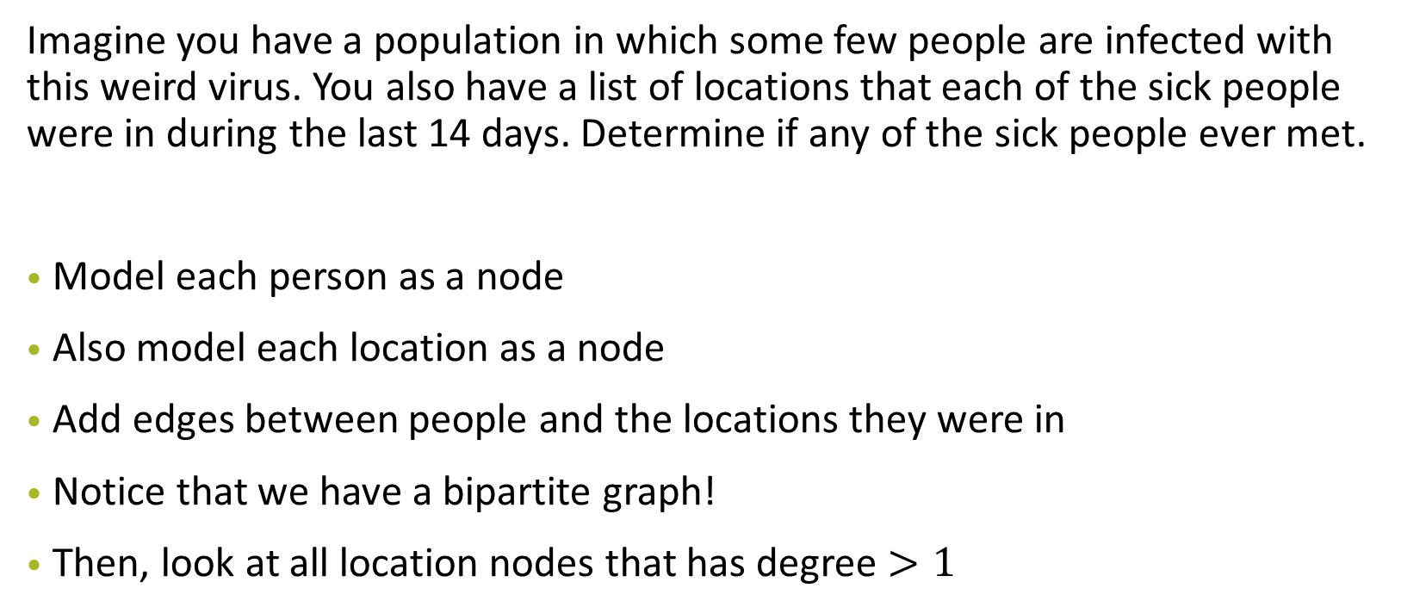
Graph Modelling

Slide 78
Graph Modelling
Imagine you have a list of cities. Some pairs of cities are also connected to each other by roads, however, these roads are pay-per-use and one must pay a certain toll (different for each road) to travel on that road! Find the cheapest way to travel from city A to city B.

Slide 79
Graph Modelling
Imagine you have a list of cities. Some pairs of cities are also connected to each other by roads, however, these roads are pay-per-use and one must pay a certain toll (different for each road) to travel on that road! Find the cheapest way to travel from city A to city B.
Model each cities as nodes
Add edges between cities if theres a road connecting the two cities
Weight of each edge is the toll of the road
Search for path between cities A and B that incurs the lowest total toll

Slide 80
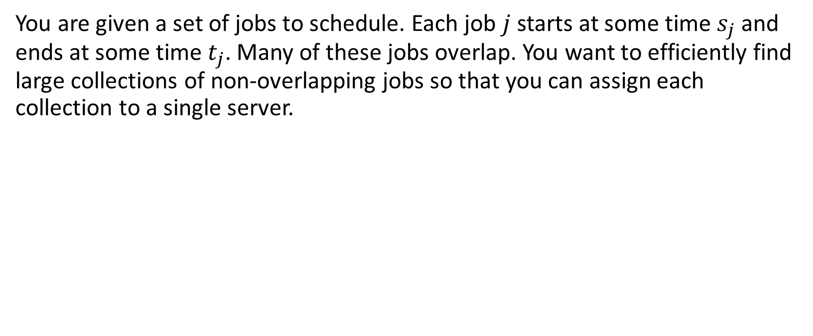
Graph Modelling

Slide 81
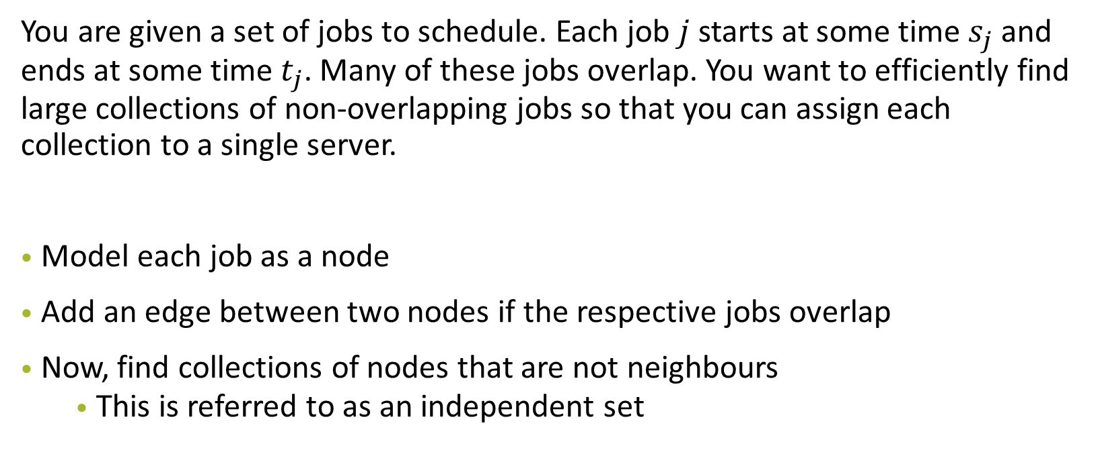
Graph Modelling

Slide 82
Graph Modelling
An English professor complains that students in their class are cheating. The professor suspects that the cheating students are all copying their material from only a few different sources, but does not know where they are copying from. Students that are not cheating, on the other hand, all submit fairly different solutions. How should we catch the cheaters?

Slide 83
Graph Modelling
An English professor complains that students in their class are cheating. The professor suspects that the cheating students are all copying their material from only a few different sources, but does not know where they are copying from. Students that are not cheating, on the other hand, all submit fairly different solutions. How should we catch the cheaters?
Model each student’s essay as a node
Add an edge between two nodes if the respective essays are similar
A cluster of nodes all connected to each other likely indicates cheating

Slide 84
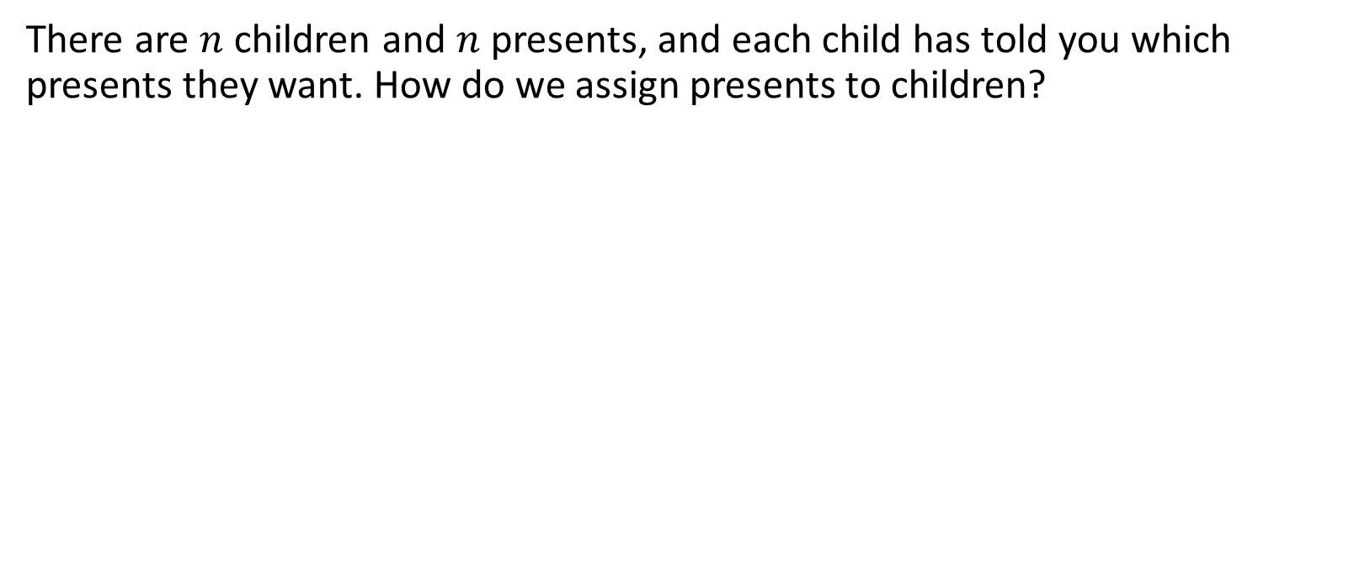
Graph Modelling

Slide 85
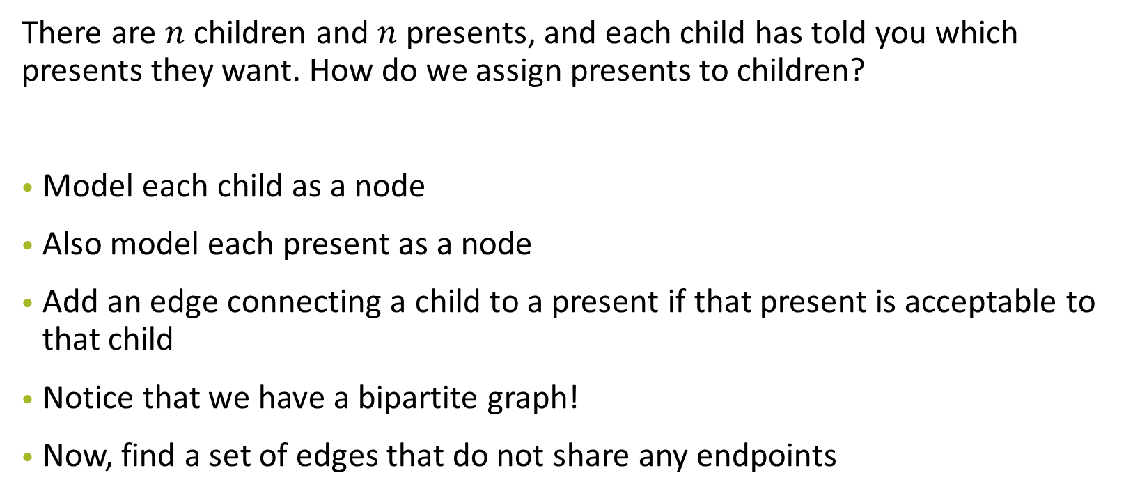
Graph Modelling

Slide 86
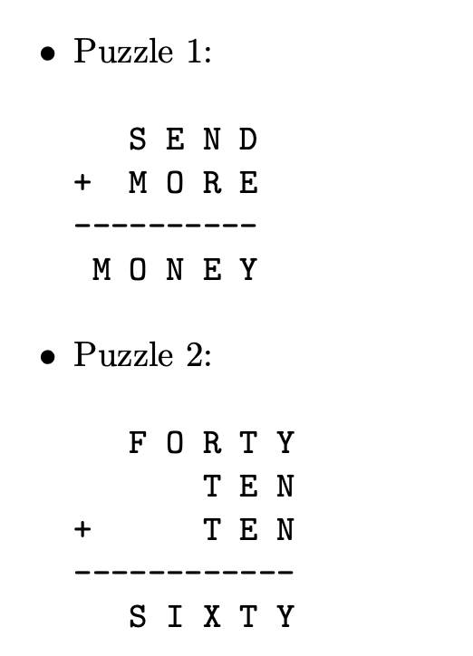
Problem 5a
Explain how to model the problem as a graph search problem.

Slide 87
Problem 5a
Node:
Edges:

Slide 88
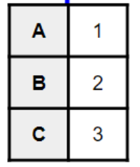
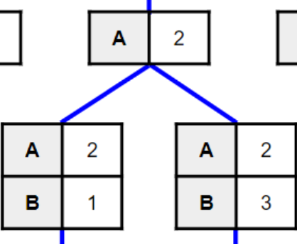
Problem 5a
Node: Assignments
Edges: Assigning one more letter
I.e. 2 nodes are connected by an edge if one node is the result of assigning one more letter to the previous node

Slide 89
Problem 5a
Start node:
Goal:

Slide 90
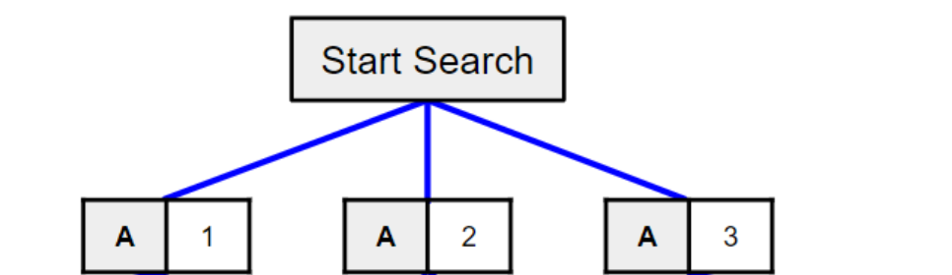
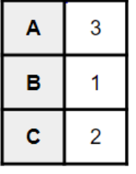
Problem 5a
Start node: Nothing assigned
Goal: All letters assigned and node is valid (no constraint is violated)
E.g. For A - B = C
Goal would be

Slide 91
Problem 5b
DFS or BFS?

Slide 92
Problem 5b
DFS or BFS?
We don’t have to search the entire tree, just find a single legal assignment of all letters
Asymptotically (i.e. worst case), there is no difference in using DFS or BFS

Slide 93
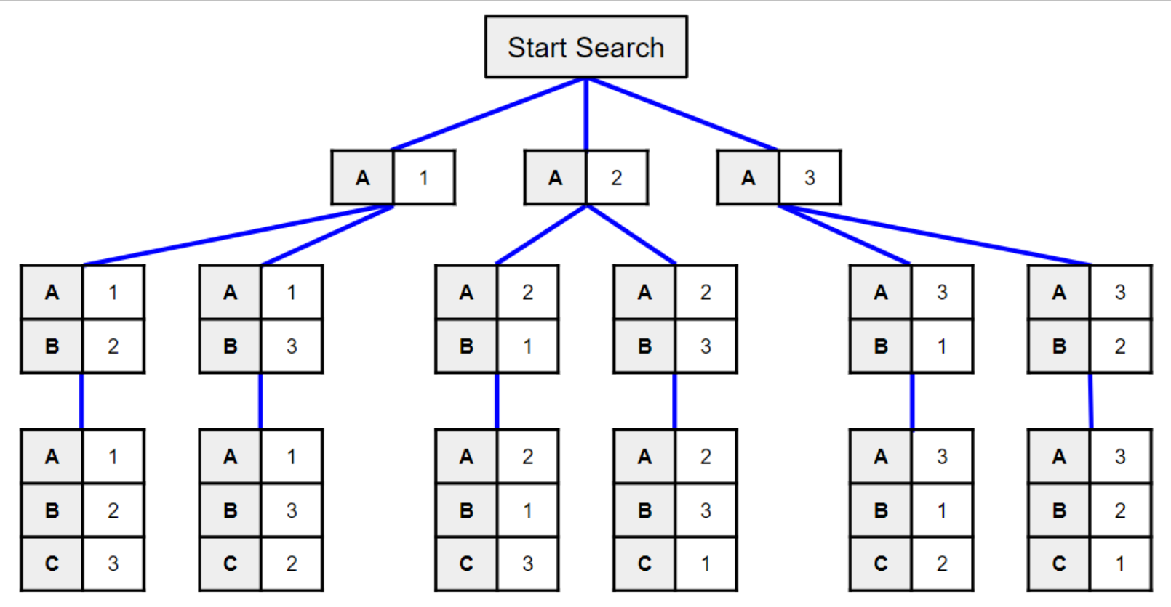
Problem 5b

Slide 94
Problem 5b
If this is a possible solution, can return this and stop searching further

Slide 95
Problem 5b
If this is a possible solution, can return this and stop searching further

Slide 96
Problem 5b
Worst case still searches through everything

Slide 97
Problem 5b
What do you observe about this graph?

Slide 98
Problem 5b
What do you observe about this graph?
Tree

Slide 99
Problem 5b
How to make it run faster?
Heuristics
The choice of which variable to assign first, which value to assign to a variable first can help invalidate large subtrees earlier (pruning)
Save on wasteful computation

Slide 100
Problem 5c
When does your search finish? Can you optimize the algorithm to minimize the amount of searching?

Slide 101
Problem 5c
At every node, check if partial assignment is valid:
If valid: Continue searching down the node (aka continue making assignments)
If not valid: Stop searching along down the subtree of this node

Slide 102
Problem 5
Constraint-satisfaction problem (CSP) which you’ll see in AI
Key learning point: How to model a problem with graphs

Slide 103
Problem 6
We have to divide students into good and bad. Tutors each create a set of cards. Each card contains the names of two students. One of the two names is a good student, and the other is a bad student. Unfortunately, they do not indicate which is which.
It is not certain that the cards are consistent: maybe one tutor thinks that Humperdink is a good student, while another tutor thinks that Humperdink is a bad student. (And Humperdink may appear on several different cards.) In addition, the tutors do not provide cards for every student.
Assume you can read the names on a card in O(1) time and that there are more good students than bad students.

Slide 104
Problem 6
Node:
Edges:

Slide 105
Problem 6
Node: Students (Alice, Bob, Charlie, Demon, Elliot)
Alice
Bob
Edges: Students that are on the same card are connected by an edge

Slide 106
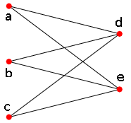
Problem 6: Consistent?
If the cards are consistent, our graph will look something like this:
Alice
Demon
Bob
Elliot
Charlie

Slide 107
Problem 6: Consistent?
If the cards are consistent, our graph will look something like this:
Alice
Demon
Elliot
Bipartite graph
Essentially, we want to find out if our graph is bipartite
Bob
Charlie

Slide 108
Problem 6: Consistent?
Graph coloring
If the notecards are consistent, then you should be able to color the graph with two colors (e.g. green and blue) such that for every edge, one node must be green and one node must be blue

Slide 109
Consistent example
Alice
Demon
Alice
Eliot
Eliot
Charlie
Demon
Charlie
Demon
Bob
b
a
d
e
c

Slide 110
Consistent example
Alice
Demon
Alice
Eliot
Eliot
Charlie
Demon
Charlie
Demon
Bob
b
a
d
e
c

Slide 111
Consistent example
Alice
Demon
Alice
Eliot
Eliot
Charlie
Demon
Charlie
Demon
Bob
b
a
d
e
c

Slide 112
Consistent example
Alice
Demon
Alice
Eliot
Eliot
Charlie
Demon
Charlie
Demon
Bob
b
a
d
e
c

Slide 113
Inconsistent example
Alice
Demon
Alice
Eliot
Eliot
Charlie
Bob
Charlie
Demon
Bob
b
a
d
e
c

Slide 114
Problem 6: Sufficient?
Is there more than one way to assign students to good/bad?

Slide 115
Problem 6: Sufficient?
Is there more than one way to assign students to good/bad?
Connected graphs: No, only one way (i.e. sufficient). We use this info:
“there are more good students than bad students.”
→ Color with more nodes: represents “good”

Slide 116
Problem 6: Sufficient?
Is there more than one way to assign students to good/bad?
What if we have multiple connected components?

Slide 117
Problem 6: Sufficient?
Is there more than one way to assign students to good/bad?
What if we have multiple connected components?
Alice
Demon
Demon
Bob
Eliot
Charlie
d
b
a
e
c
c
e
How to assign? We don’t know

Slide 118
Problem 6: Sufficient?
Is there more than one way to assign students to good/bad?
Essentially we want to find out if our graph is connected

Slide 119
Problem 6: Algorithm
Choose any student, and begin performing a BFS
For each node, the first time it is visited in the BFS, label it with its level (i.e., the root is level 0, its neighbors are level 1, its neighbors neighbors are level 2, etc.).
If BFS completes and there are still unvisited nodes, we can run BFS again on any unvisited node if we still desire to find some pairing for the insufficient case.

Slide 120
Problem 6: Algorithm
Sufficient: If all nodes are visited during the first run of BFS, then the data is sufficient.
Consistent: If any node with an even level has a neighbor with an even level, then the data is inconsistent (same for nodes on odd levels).
Assigning to good and bad (if consistent and sufficient):
Whichever even/odd level has more nodes, they are the good group.

Slide 121
Problem 7: Gone viral
There are n students in the National University of Singapore. Among them, there are n − 1 friendships. Note that friendship is a symmetric relation, but it is not necessarily transitive. Any two people in the National University of Singapore are either directly or indirectly friends. It was discovered today that two people were found to have the flu in the National University of Singapore. Every day, every person can meet with at most one friend. When these two people meet, if exactly one of them has the flu, it will be transmitted to the other.
Give an O(n log² n) algorithm to determine the minimum possible number of days before it is possible that everyone has the flu.
Hint: First, solve the case where there is only a single person was infected at the start in O(n log n).

Slide 122
Problem 7: Gone viral
What type of graph is this?
Tree
There are n students in the National University of Singapore. Among them, there are n − 1 friendships. Note that friendship is a symmetric relation, but it is not necessarily transitive. Any two people in the National University of Singapore are either directly or indirectly friends (connected graph). It was discovered today that two people were found to have the flu in the National University of Singapore. Every day, every person can meet with at most one friend. When these two people meet, if exactly one of them has the flu, it will be transmitted to the other.
Give an O(n log² n) algorithm to determine the minimum possible number of days before it is possible that everyone has the flu.
Hint: First, solve the case where there is only a single person was infected at the start in O(n log n).

Slide 123
Problem 7
Node:
Edges:

Slide 124

Problem 7
Node: Students
Edges: Friendship
(A and B are connected by an edge if they are friends)

Slide 125

Problem 7: 1 infected case
We want to find f(x) of root
Let f(x) = days needed for all nodes in the subtree at x to be infected
remember there are no cycles, because the problem states it is a tree!
Leaf nodes
f(x) = 0

Slide 126
Problem 7: 1 infected case
Let f(x) = days needed for all nodes in the subtree at x to be infected
Internal nodes:
f(x) = max(f(A) + 1, f(B) + 2) or max(f(B) + 1, f(A) + 2)
A
B
Leaf nodes
f(x) = 0
Notes:
Each subtree can be unbalanced

Slide 127
Problem 7: 1 infected case
Internal nodes:
f(x) = max(f(A) + 1, f(B) + 2) or max(f(B) + 1, f(A) + 2)
Let f(x) = days needed for all nodes in the subtree at x to be infected
We want to minimise f(x) so we should sort f(c₁), f(c₂), …, f(c_{k})
c₁, c₂, …c_{k} ⇒ Children of node x
Largest f(c_{i}) + 1, 2nd largest + 2 … etc.
A
B

Slide 128
Problem 7: 1 infected case
We want to minimise f(x) so we should sort f(c₁), f(c₂), …, f(c_{k})
c₁, c₂, …c_{k} ⇒ Children of node x
Largest f(c_{i}) + 1, 2nd largest + 2 … etc.
Time complexity?

Slide 129
Problem 7: 1 infected case
We want to minimise f(x) so we should sort f(c₁), f(c₂), …, f(c_{k})
c₁, c₂, …c_{k} ⇒ Children of node x
Largest f(c_{i}) + 1, 2nd largest + 2 … etc.
Time complexity?
O(k log k) for an internal node with k children
-> Overall: O(nlogn)

Slide 130
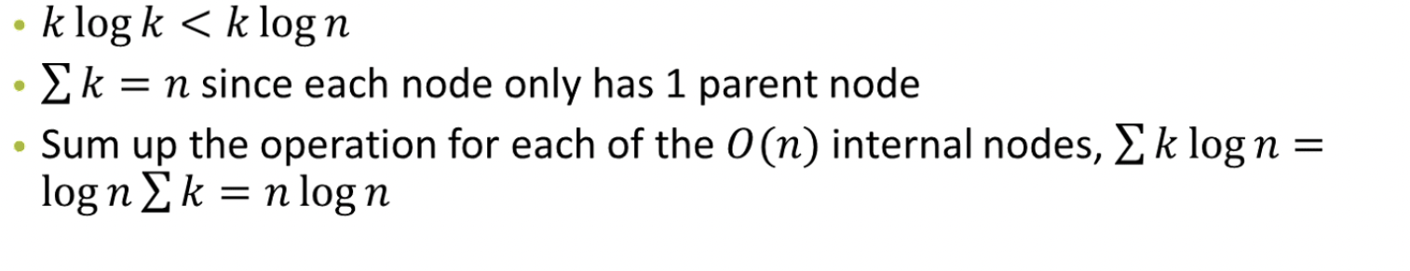
Problem 7: 1 infected case
We want to minimise f(x) so we should sort f(c₁), f(c₂), …, f(c_{k})
c₁, c₂, …c_{k} ⇒ Children of node x
Largest f(c_{i}) + 1, 2nd largest + 2 … etc.
Time complexity?
O(k log k) for an internal node with k children
-> Overall: O(nlogn)

Slide 131
Problem 7: 2 infected case
key idea from going from 1 infected case to 2 infected case:
It is a tree - this means there is only one path from a node to any other node
If there are 2 infected students, every node can be infected by either student A or student B
Cutting an edge of the graph leads to two connected, disjoint graphs -> which can be solved with the first case.

Slide 132
Problem 7: 2 infections case
We can split this path into nodes infected by A and nodes infected by B
The nodes along this path may have subtrees of its own
…
B
A

Slide 133
Problem 7: 2 infections case
We can split this path into nodes infected by A and nodes infected by B
If tree containing A needs more days to infect all nodes, should assign more nodes along this path to be infected by B.
…
B
A

Slide 134
Problem 7: 2 infections case
We can split this path into nodes infected by A and nodes infected by B
How to find this split? Binary search along this path
max path length is n: binary search = O(logn)
Performance: O(nlog²n)
…
B
A

